Slide 1

Online Shoppers Purchasing Intention
Group member: Junyi Li , Chuxiang Zhou
Dataset source： http://archive.ics.uci.edu/ml/datasets/Online+Shoppers+Purchasing+Intention+Dataset

Slide 2
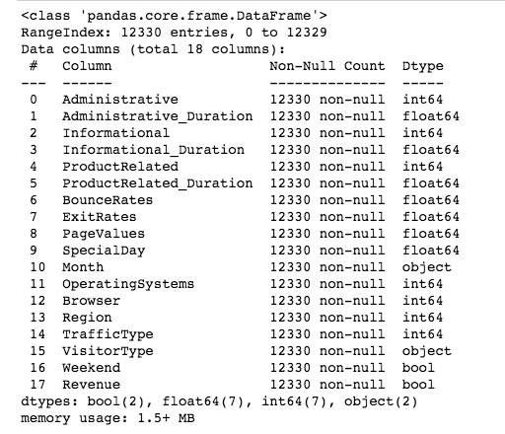
Data Attribute
10 numerical and 8 categorical attributes.

Slide 3
Reference ：
"Administrative” means page visited.
"Administrative Duration” means time was spent.
"Bounce Rate" feature for a web page refers to the percentage of visitors who enter the site from that page and then leave ("bounce") without triggering any other requests to the analytics server during that session.
The value of “Exit Rate” feature for a specific web page is calculated as for all page views to the page, the percentage that were the last in the session.
The "Page Value" feature represents the average value for a web page that a user visited before completing an e-commerce transaction.
The "Special Day" feature indicates the closeness of the site visiting time to a specific special day (e.g. Mother’s Day, Valentine's Day) in which the sessions are more likely to be finalized with transaction. The value of this attribute is determined by considering the dynamics of e-commerce such as the duration between the order date and delivery date. For example, for Valentina’s day, this value takes a nonzero value between February 2 and February 12, zero before and after this date unless it is close to another special day, and its maximum value of 1 on February 8.
The dataset also includes operating system, browser, region, traffic type, visitor type as returning or new visitor, a Boolean value indicating whether the date of the visit is weekend, and month of the year.

Slide 4
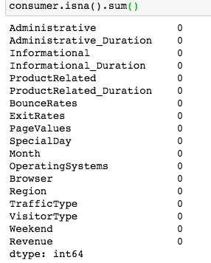
Data Quality Issues: no missing values and 125 sample size of duplicate (total size: 122, 330)
Total dataset is 12,330, but duplicate number is only 125.
We are no very sure whether they are accidently same，
and their sample size is very small.
Therefore, it is better that we not delete them.

Slide 5
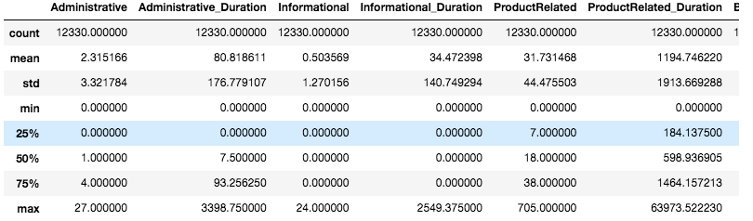
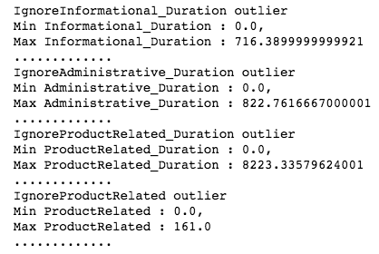
Outlier remove: we remove out the last 1% part.

Slide 6
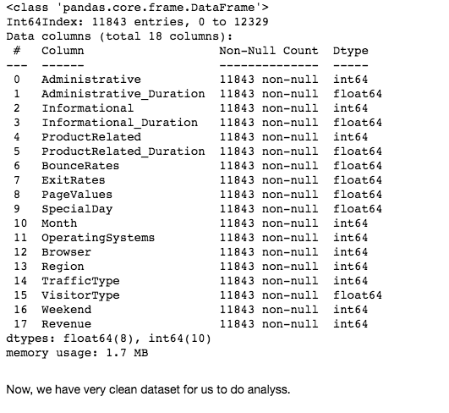
1 , 0
Change Boolean and month strings to integers
For better analysis,
We change the value of weekend and revenue from boolean to 1 or 0.
( 1's indicates weekends and 0's means not weekend. )
For Visitor Type, which includes 'Returning_Visitor' and 'New_Visitor', to 1 and 0.
(1's indicates returning visitor, and 0's indicates new visitor.)
We alse change the month string values to integers (1-12).

Slide 7
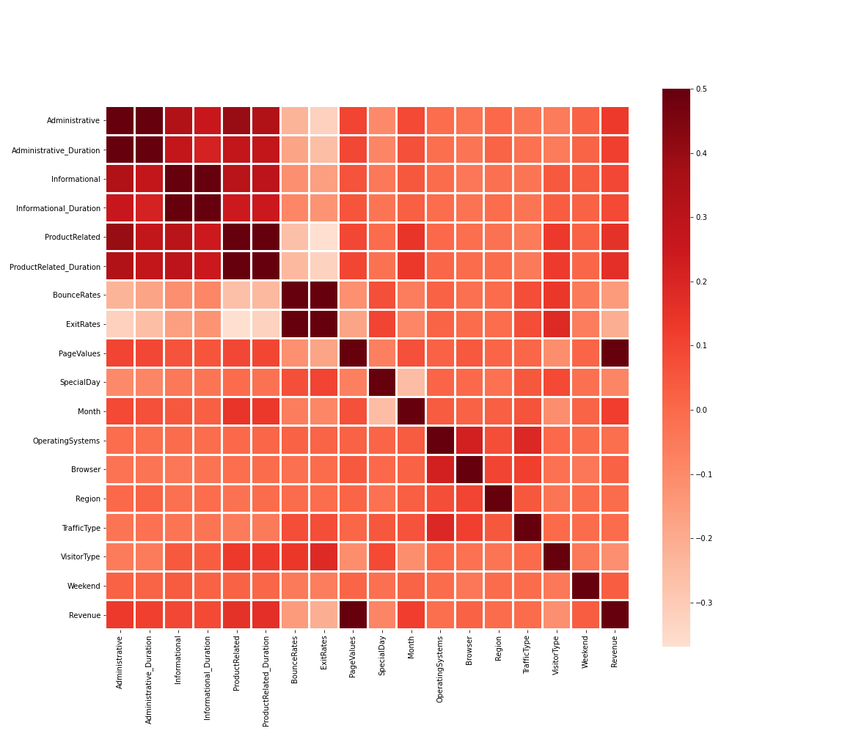
From Heatmap, Revenue has the strongest
correlation with page values.
It has moderate correlations with webpage
visited and duration spent on the
information, administration,
Product related pages.
For more precise detail analysis,
we use corr() function.

Slide 8
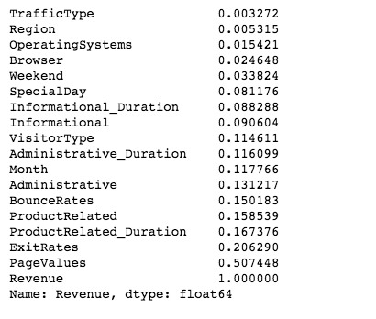
Their correlation with Revenue :
We delete TrafficType, Region,
Operating Systems, Brower, Weekend,
as they have very low correlation with revenue.
Then, we standardize dataset for better analysis.

Slide 9
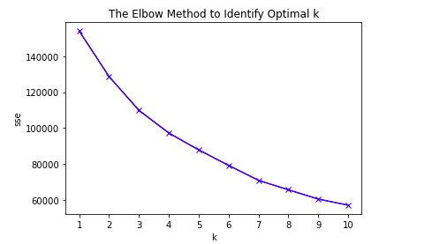
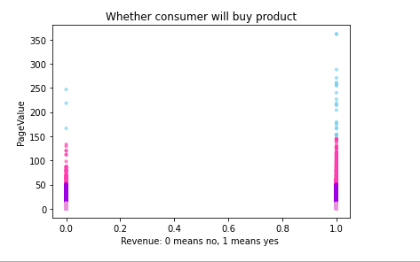
Clustering : k-mean
We can't clearly see the elbow point,
Therefore, we will use a Python package, kneed,
to identify the elbow point programmatically
Optimal K is 4.

Slide 10
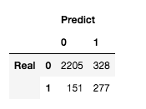
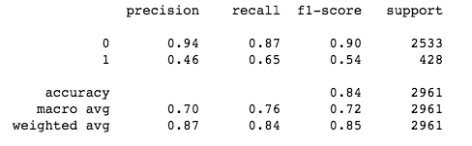
Clustering : GaussianNB method
The accuracy score is 83.8%

Slide 11
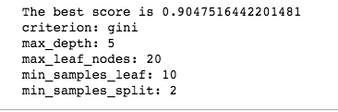
Classification :DecisionTreeClassifier() and GridSearchCV ()
DecisionTreeClassifier()
Accuracy: 87.0%
Tuning Hyperparameters : GridSearchCV(clf, param_grid, cv=10, scoring='accuracy')
Accuracy: 90.5%

Slide 12
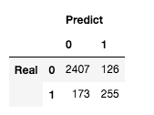
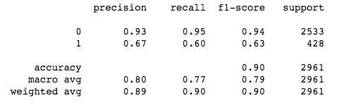
Classification :
DecisionTreeClassifier() and GridSearchCV ()

Slide 13
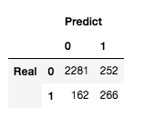
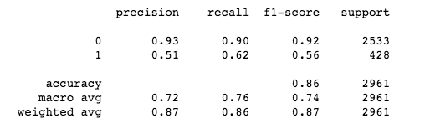
Naive Bayes
BernoulliNB()
Accuracy: 86.0%

Slide 14
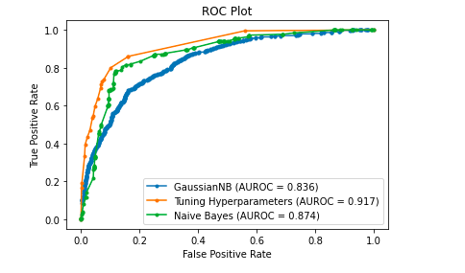
ROC and AUC
From previous analysis, we know that GaussianNB method (clustering) has accuracy 84%,
Tuning Hyperparameter accuracy 90%, and Naive Bayes 86%.
Therefore, Tuning Hyperparameter has the highest accuracy.

Slide 15
Thank you !

